Slide 1
Flickr: A Radical New Social Networking Paradigm for Photo Sharing
Michael “Mike” L. Baird
Flickr.bairdphotos.com
Mike [at} mikebaird d o t com
Notes:
this is what I was planning to send Stu (for the hyperlinked class description on the Morro Photo Expo website)...
Why share? "A photo taken but not shared might just as well have never been taken." Learning from others. Giving versus getting in a social networking context. Preserving your Intellectual Property rights (IP), copyrights. Creative Commons licensing. Getting your photos recognized, featured, popularized. Understanding the proprietary Flickr measure of "Interestingness." Using Groups and Pools. Getting and giving critique. Netiquette - how to be a good Flickr citizen. Cloud computing trend: processing, storing, and distributing your digital photos entirely online and independent of any personal computer. Photographer's rights to take and use photos. Perpetual image hosting - Flickr promises to never erase an image! What does that mean in terms of your legacy?
Photographer Michael "Mike" L. Baird is an avid and some say addicted Flickr user, having migrated most of his Internet photo presentation sites (bairdphotos.com, stealthispicture.com, digitalchocolate.org, BirdsOfMorroBay.com...) onto Flickr, which you can find via flickr.bairdphotos.com. Mike wants to infect you with his same interest. At Flickr, Mike hosts about 5000 Morro Bay-related images which have been viewed over two million times, averaging 4000 views a day. His "most interesting" images have each garnered 20,000 views and 400 comments, and appear in 60 groups, and some are linked to or purposed with attribution from up to 200 different external sites. Because of Flickr and the related Creative Commons revolution, hundreds of his images have now been used in educational settings including State Park, National Marine Sanctuary, National Estuary Program, etc. kiosks and displays, books, pamphlets, interpretive signs, rescue cards, Coast Guard murals, birding resource sites, etc. In this presentation Mike hopes to get you excited about the possibility of projecting your photography further into the digital universe. Many of us do not realize it, but our legacy may well be represented by only those bits we leave behind on the Internet. In 500 years, what will Google and Flickr say about you?

Slide 2
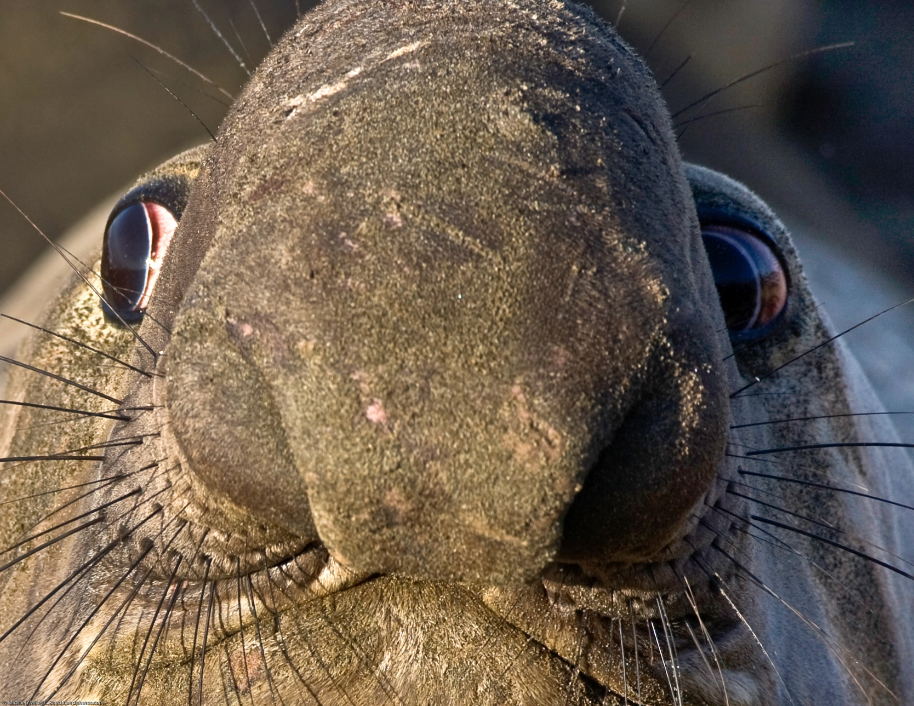
Are You Flickring me?

Slide 3
Audience Calibration
Share photos online?
How?
Ever go to Flickr.com?
Flickr user already?
Have your own website?
E-mail image attachments?
Facebook or MySpace user?
Yahoo ID?
Use Google image search?
Every hear of Creative Commons license?
Twitter – do you Tweet?

Slide 4
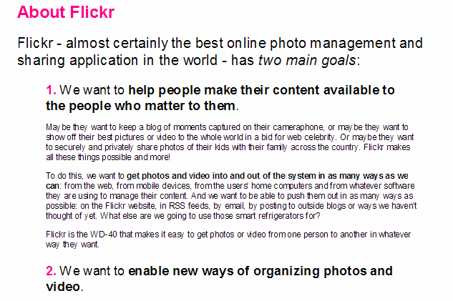
About Flickr.com, a Yahoo! Property

Slide 5
Sharing Photos
Why we share anything
Prints are expensive, non-ecological
Websites are plentiful and cheap
“A photo taken but not shared might just as well have never been taken”
“A photo published but never seen, commented on, used, is not being shared...”
Your Legacy might be just the few permanent bits you leave behind on the Internet

Slide 6
Sharing Photos...
Why Flickr and not Picasaweb, SmugMug, Webshots, Pbase, Photo.net, dotPhoto, Kodak, Shutterfly, Epson, Piczo... (relationships, reach, permanency...)
Private family moments
Web celebrity
Documentation and science
Art and appreciation
Community
Creative Commons & Wikimedia/pedia

Slide 7
Sharing by e-mail
Bad Netiquette
Flickr can notify you by e-mail of new images added by contacts, friends, family
FlickrMail facilitates one-to-one correspondence without exposing your e-mail address

Slide 8
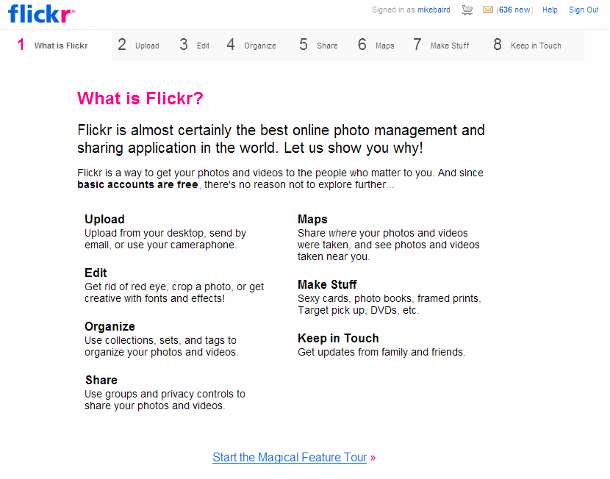
Flickr tour http://www.flickr.com/tour/

Slide 9
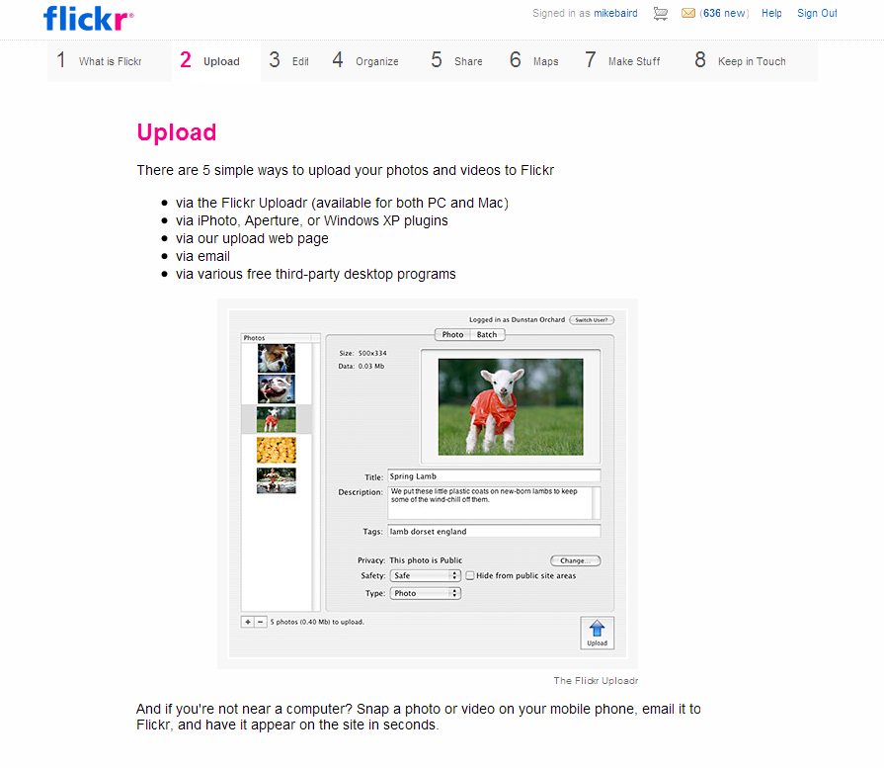
Flickr tour continued

Slide 10
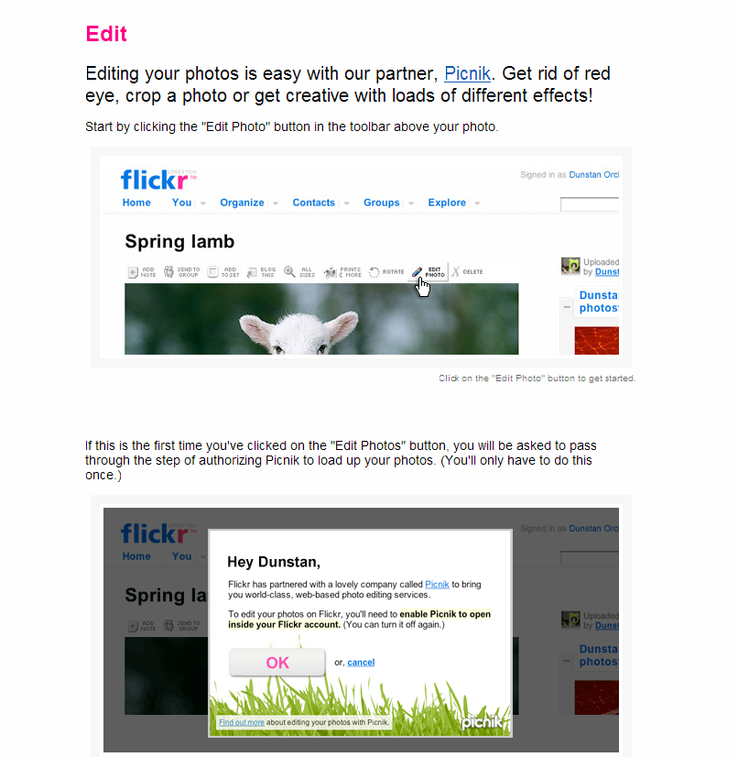
Flickr tour continued

Slide 11
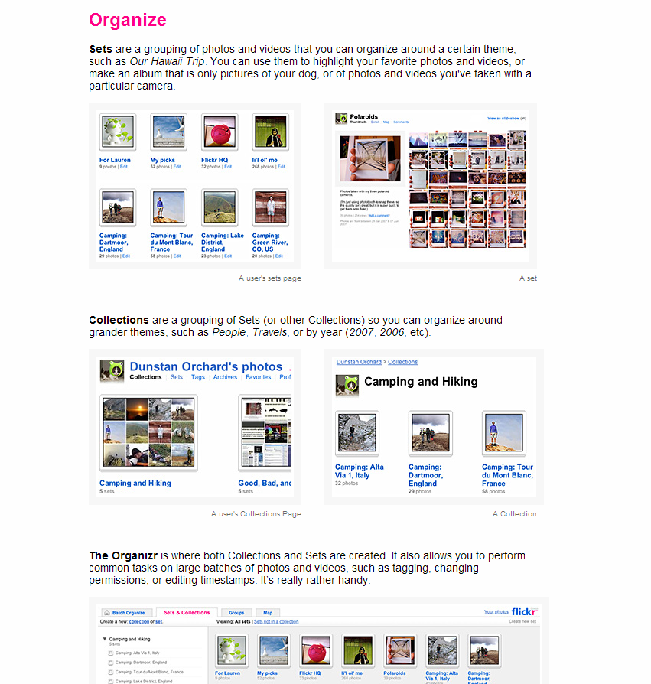
Flickr tour continued

Slide 12
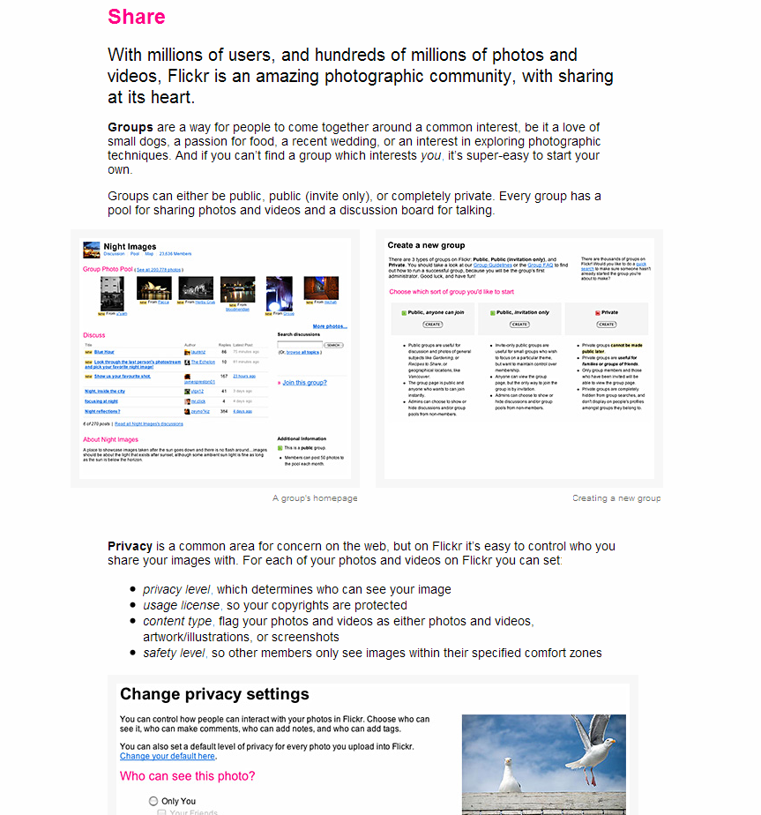
Flickr tour continued

Slide 13
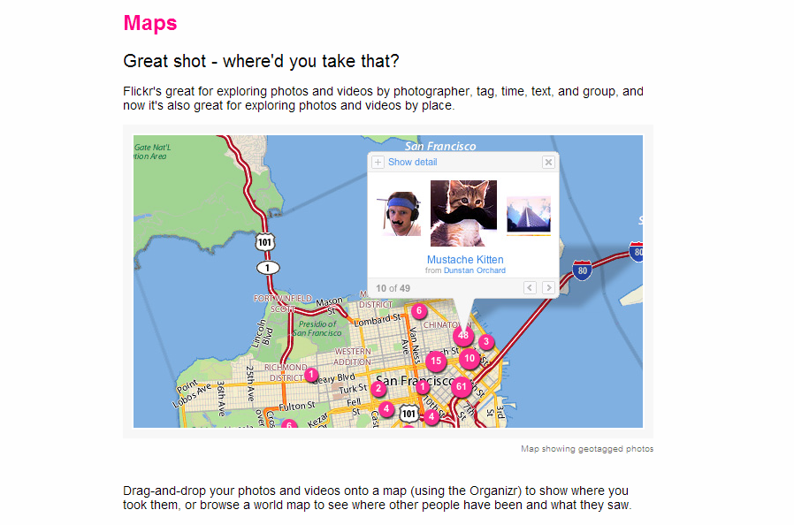
Flickr tour continued

Slide 14
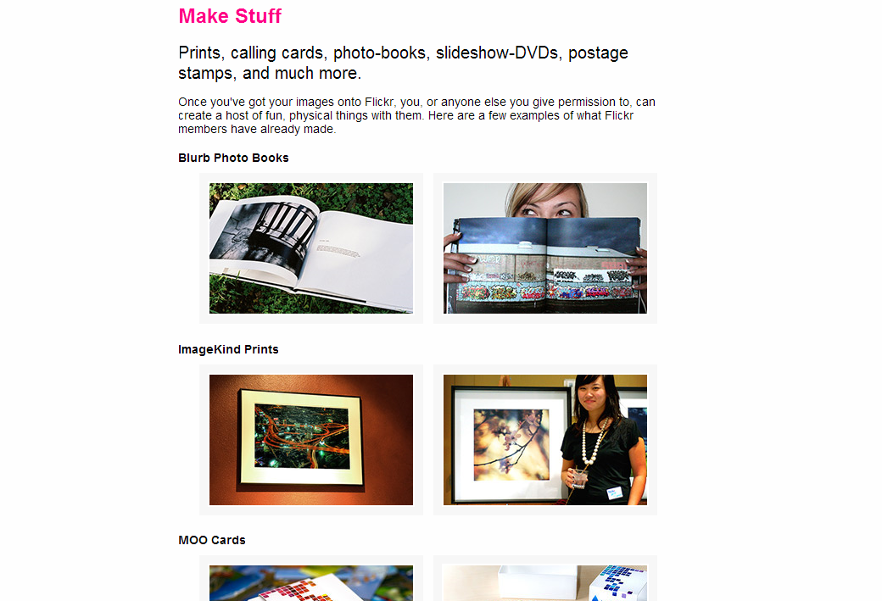
Flickr tour continued

Slide 15
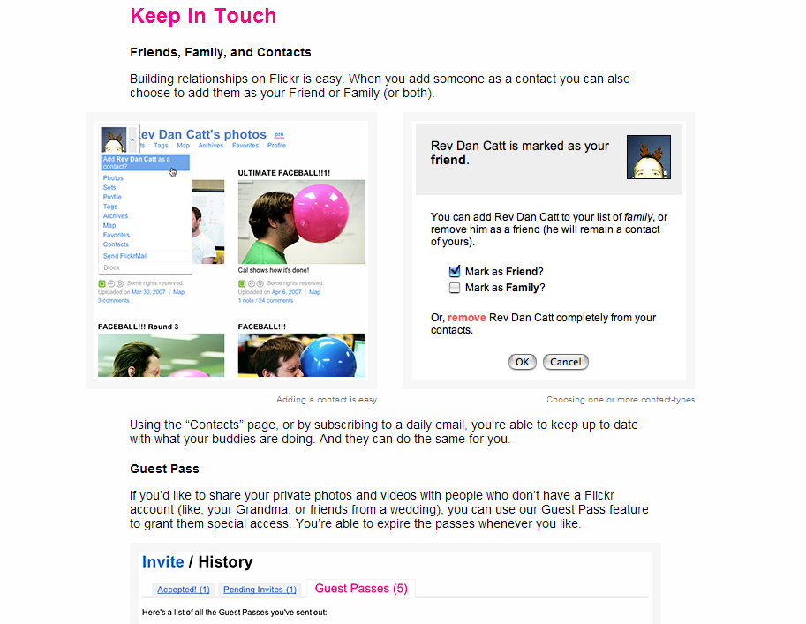
Flickr tour continued

Slide 16
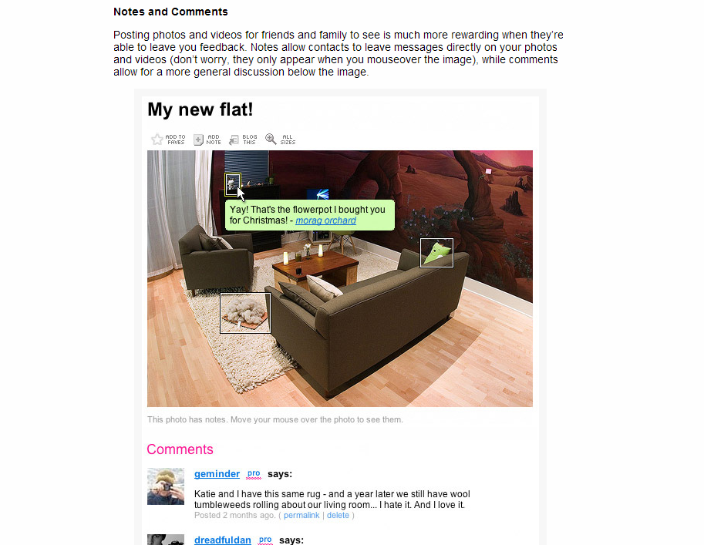
Flickr tour continued

Slide 17
Flickr is Free or ~$25/year
Yahoo! owns Flickr and has stated that they will never delete an image unless the owner deletes it.
Free account has some limits – but is a good way to learn.
The best way to learn Flickr is to use it and experiment with all the settings and options
“Pro” account allows unlimited uploads, unlimited sets, 20MB images...

Slide 18
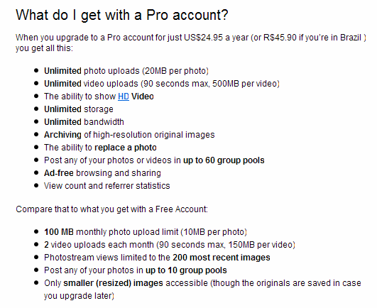
Pro Accounts ~$25/year

Slide 19
Your Flickr Photos will Never be Deleted
http://www.flickr.com/help/limits/#84 says... Q: Are my photos ever deleted? A: your photos will not be deleted, unless you do it yourself, or fail to play by our Community Guidelines

Slide 20
Strategies & Philosophies
Upload one or two photos per day
Upload every photo taken
Reputation – do you want friends notified of your junk images?
Flickr is used by some of the biggest names in the business as a way to interact with their community – but in these cases Flickr supplements other more professional web presences.
Flickr’s TOS prohibit commercialism

Slide 21
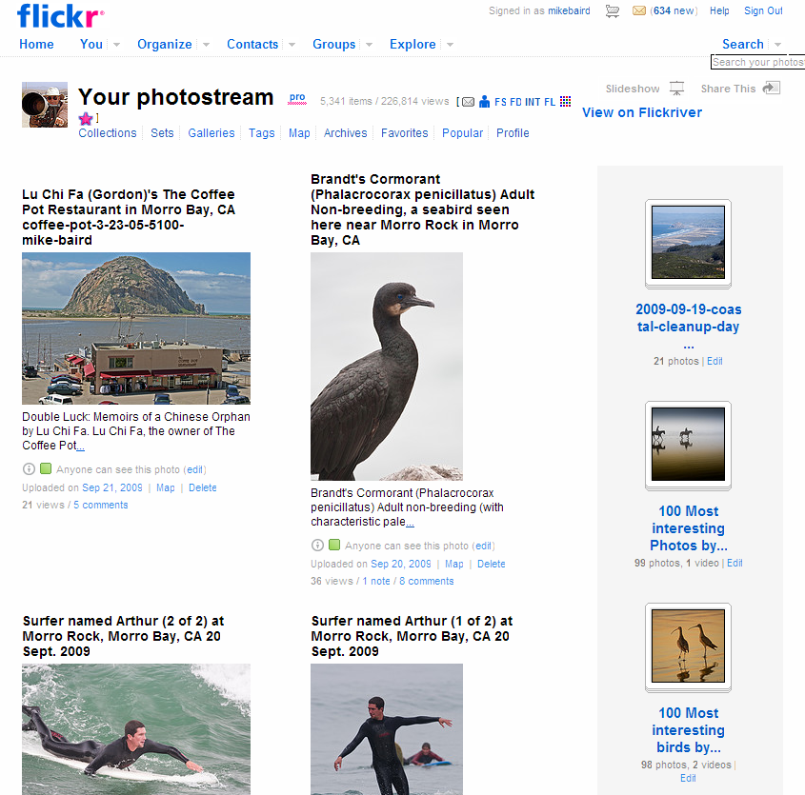
Photostream concept

Slide 22
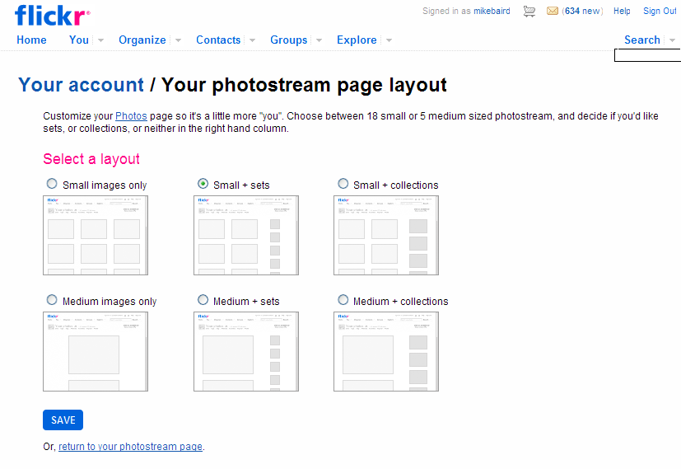
Present your Photostream

Slide 23
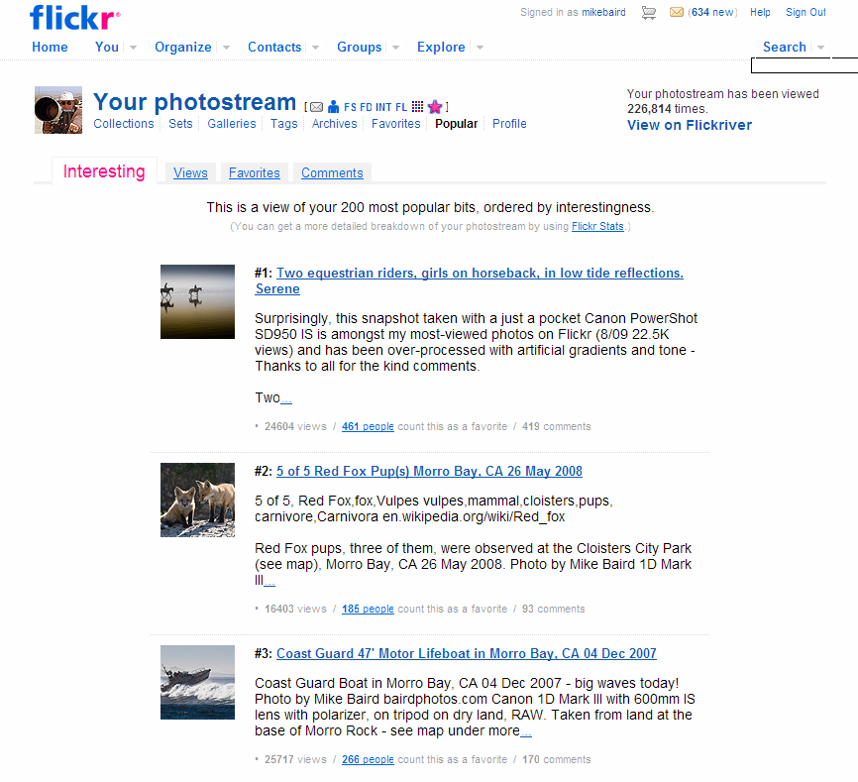
View by “Popular” - Interesting

Slide 24
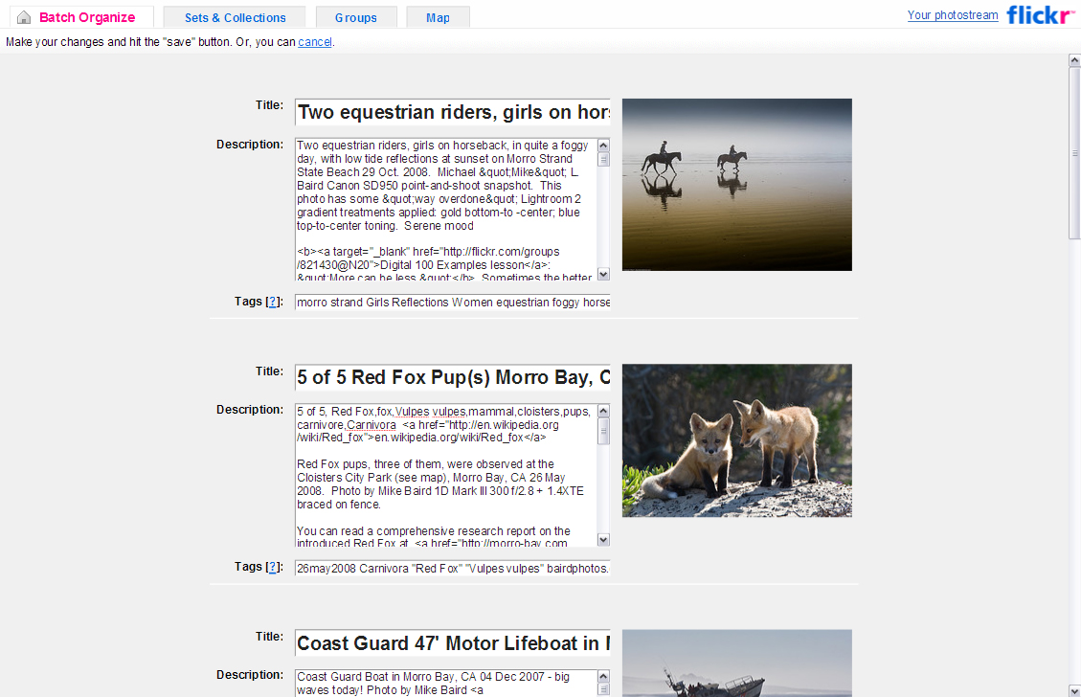
Edit Title, Desc., Tags

Slide 25
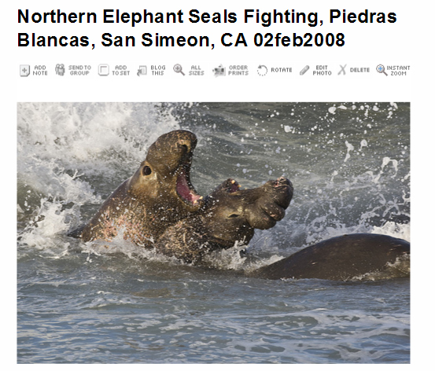
Operations on images

Slide 26
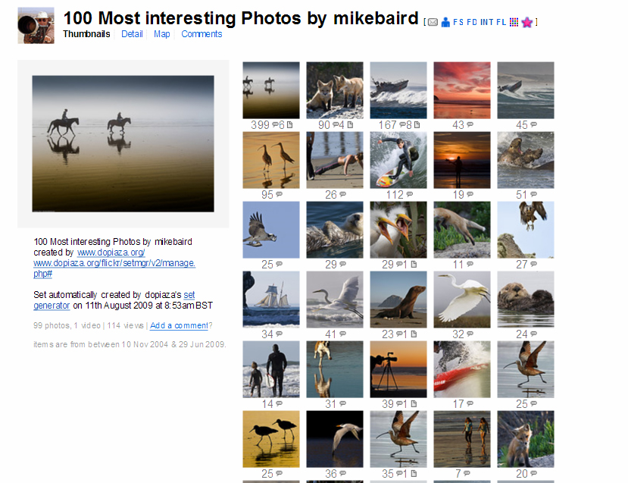
Robust views
Template 28 Arial

Slide 27
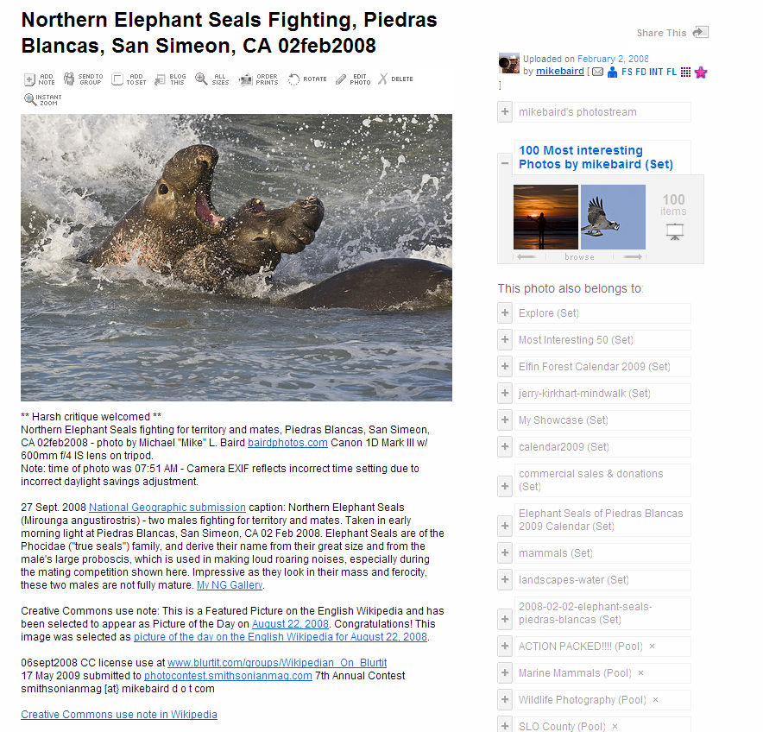
Detail views

Slide 28
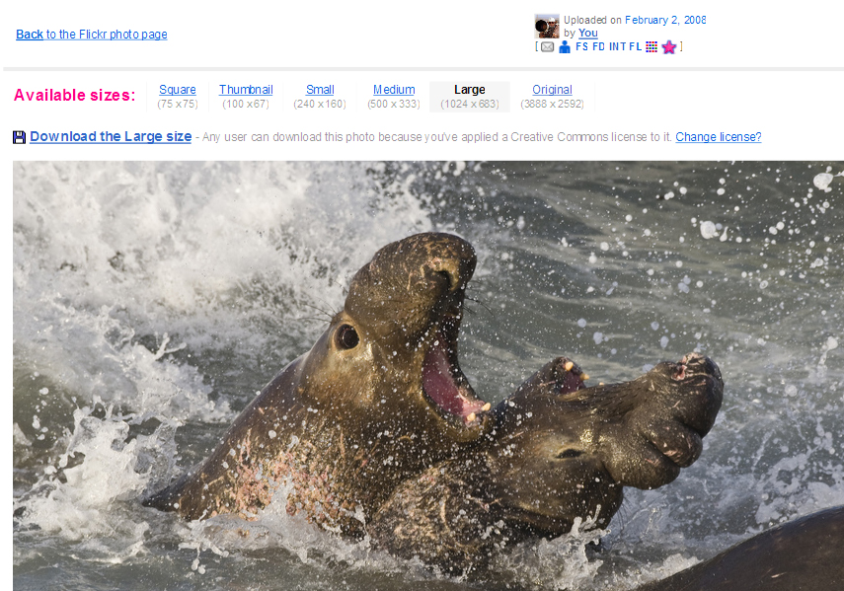
View Large

Slide 29
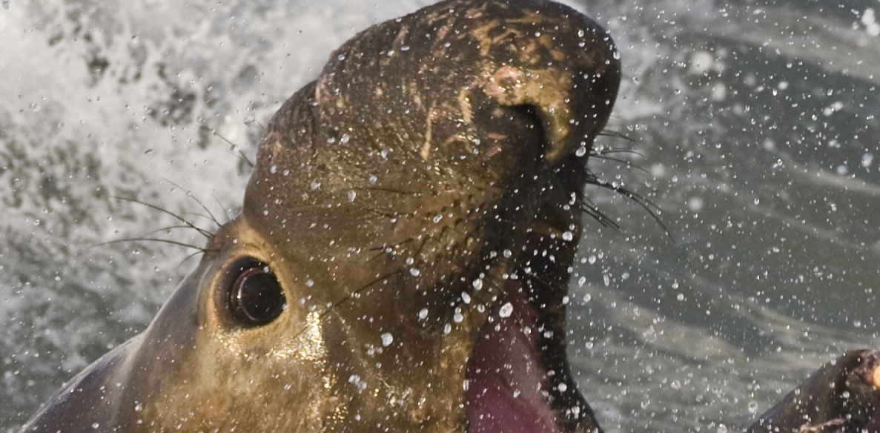
View full resolution pixels

Slide 30
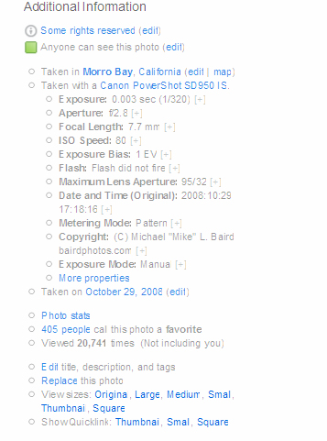
Share Camera EXIF
Copyright
(Creative Commons)
Shutter speed, aperture
ISO, lens, Camera model,
©, map GPS, Stats
“An image shared but not displayed in full resolution, with hidden
EXIF, is not really being shared

Slide 31
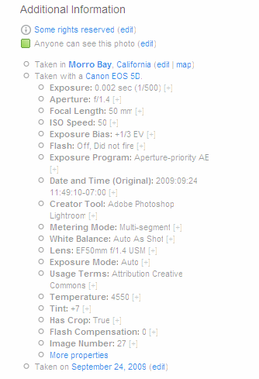
Learn by exposing EXIF
Exif Viewer
by Alan Raskin

Slide 32
Getting Found and Used, SEO (Search Engine Optimization) for Flickr Images
Robust Descriptions (Ref. Wikipedia.org)
Robust Title (include scientific name)
Robust Tags (disambiguate words)
Add to Relevant Groups
Add to CC-related Groups, Wikimedia Commons
Use Creative Commons (CC) Attribution
Allow Download of Full-resolution version
Links to your images from CC uses
Find a Wikipedia writer who likes your photos

Slide 33
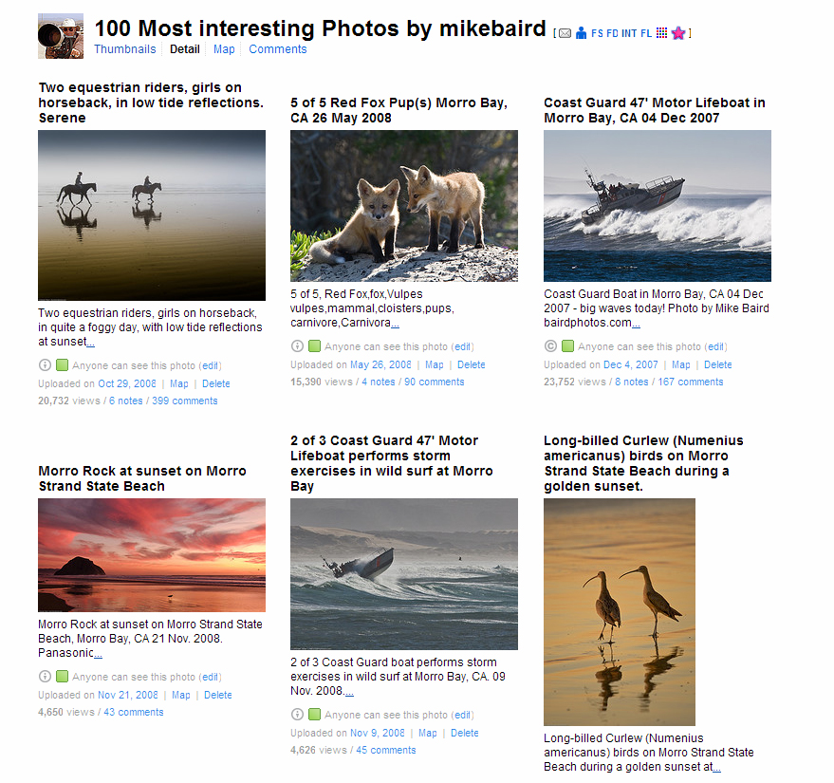
Sets and Collections

Slide 34
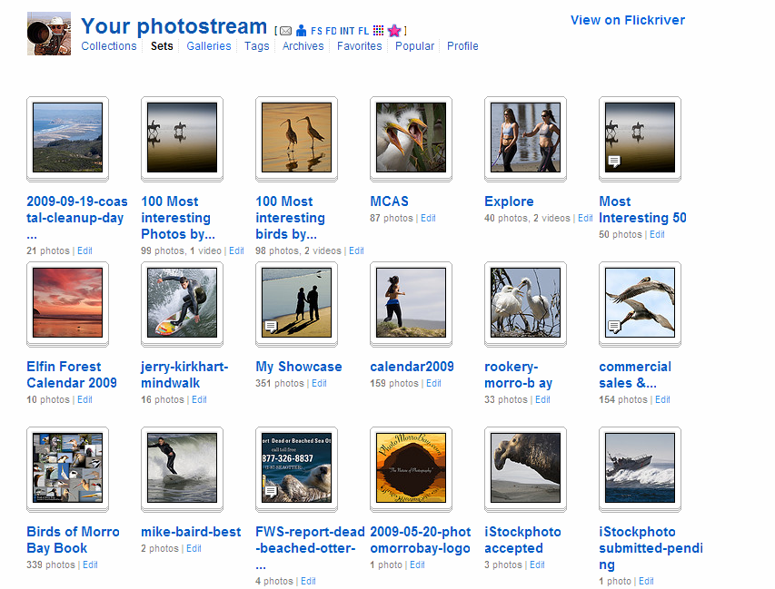
Your Sets

Slide 35
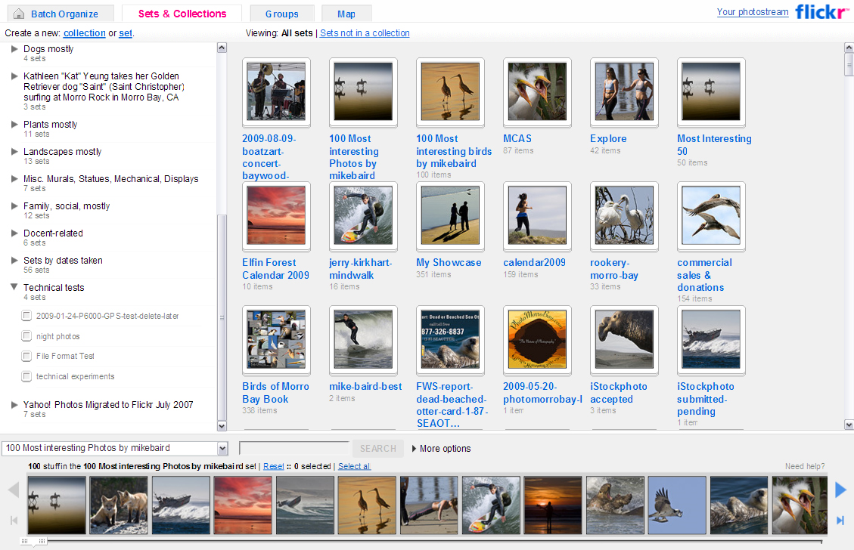
Add images to sets, collections

Slide 36
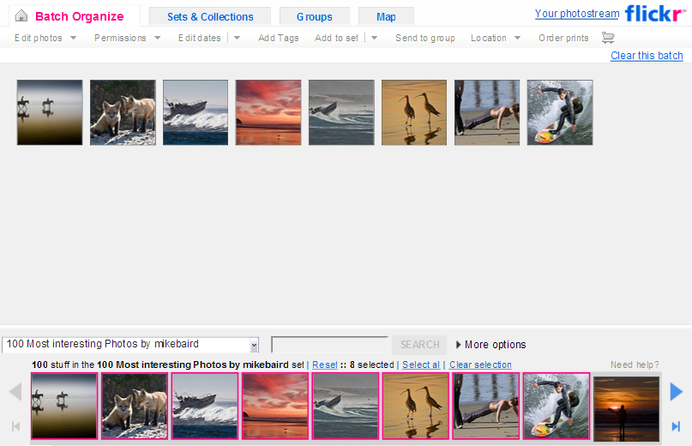
Batch Organize

Slide 37
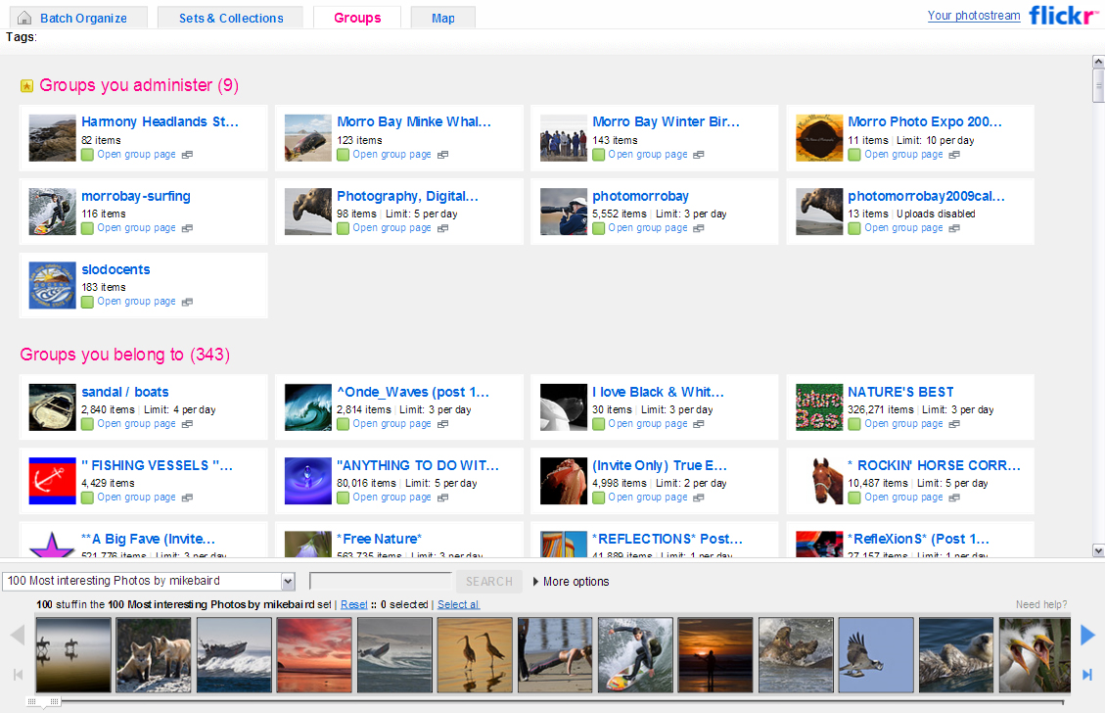
Add images to Groups/Pools

Slide 38
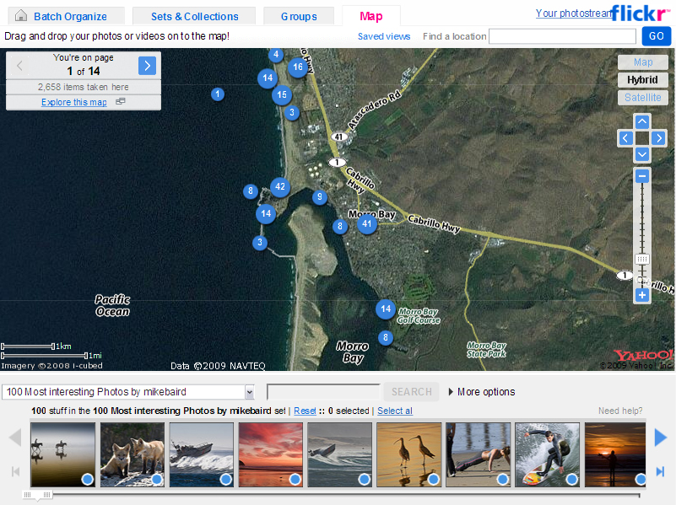
Plot locations on map

Slide 39
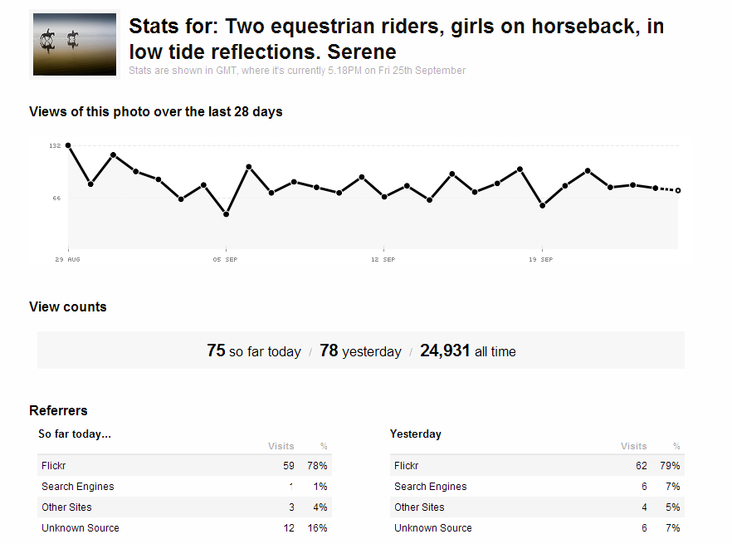
Individual Image Statistics

Slide 40
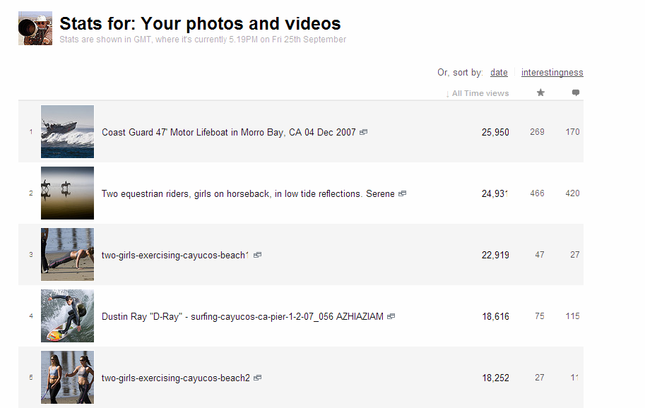
Stats for your photos/videos

Slide 41
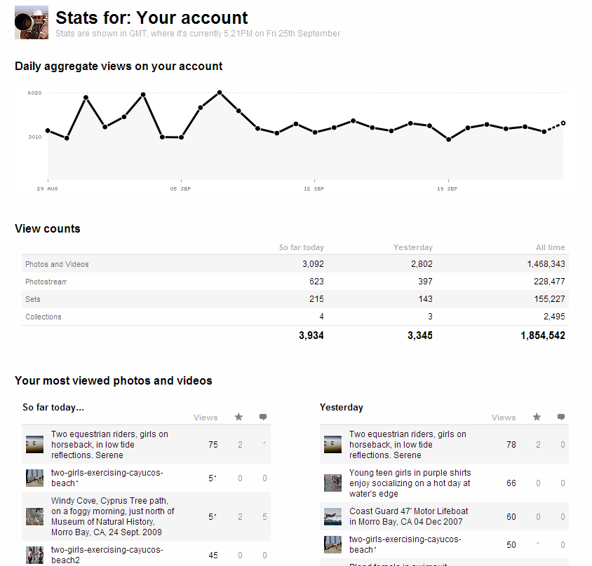
Account Statistics

Slide 42
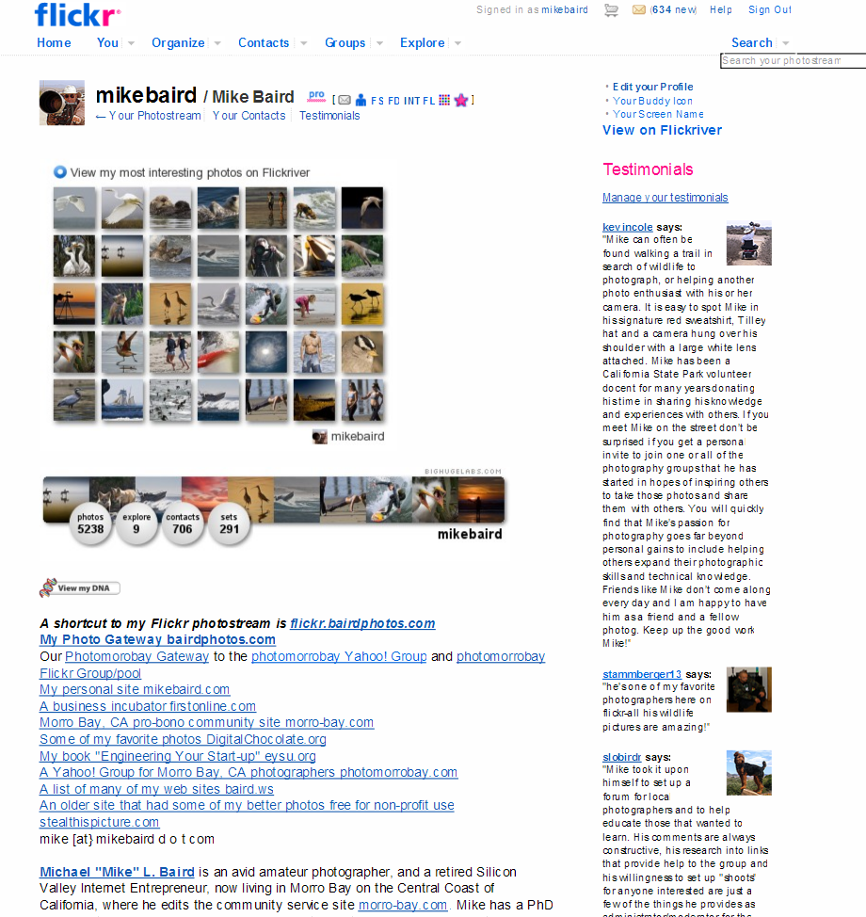
Create a Profile

Slide 43
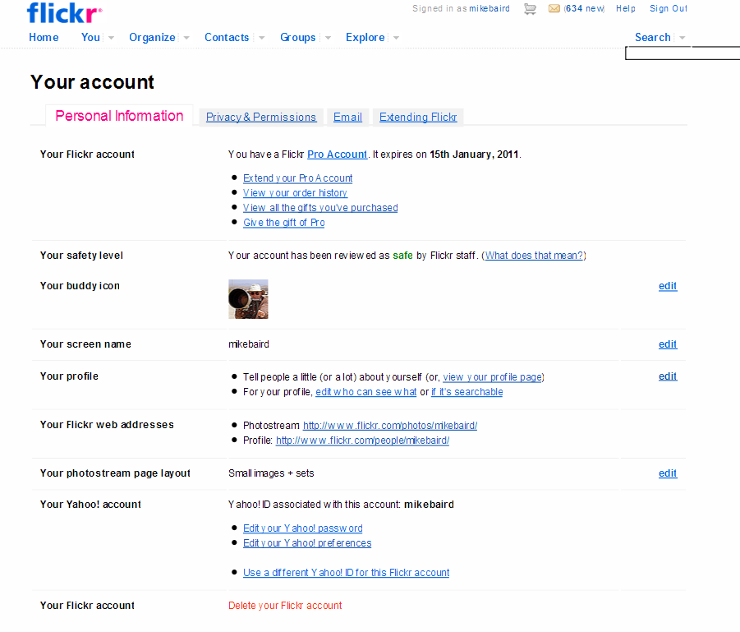
Customize your Account

Slide 44
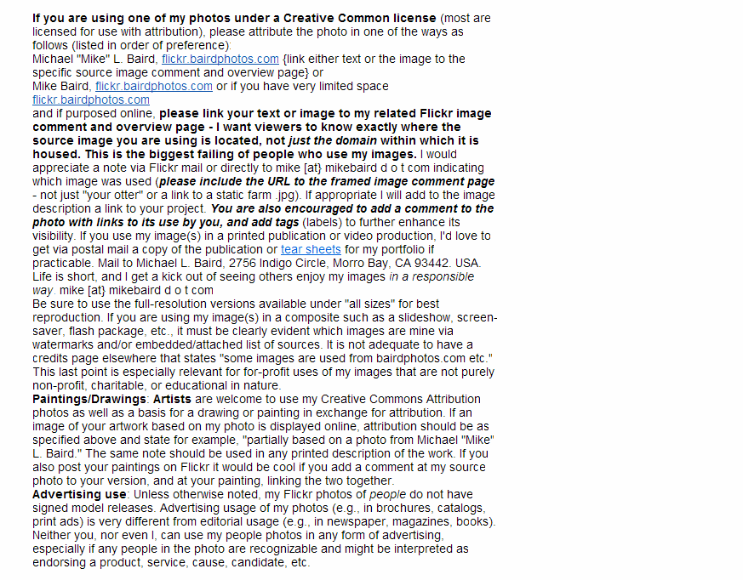
Your Profile sharing details

Slide 45
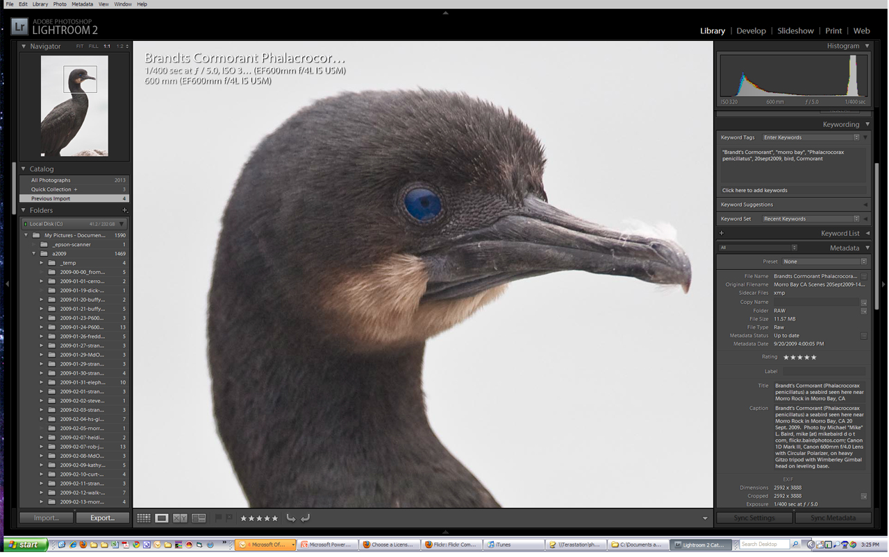
Third Party Tools: Adobe Lightroom, Bridge, Photoshop...

Slide 46
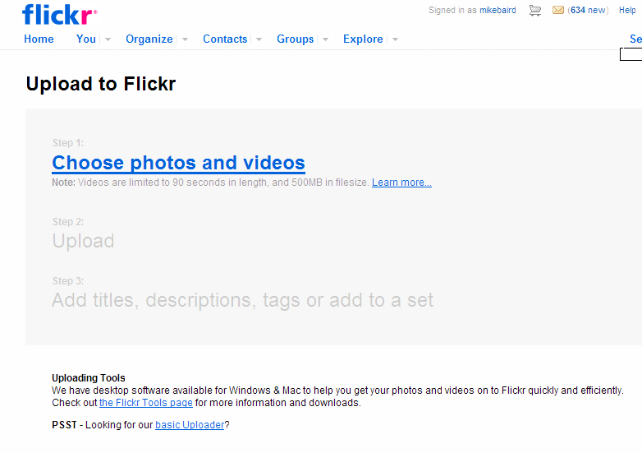
Upload Photos or Video

Slide 47
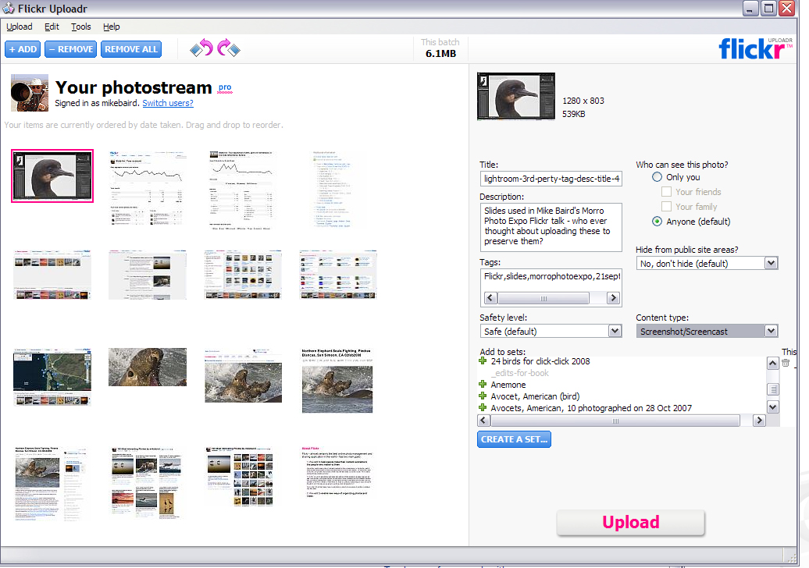
Flickr Uploadr

Slide 48
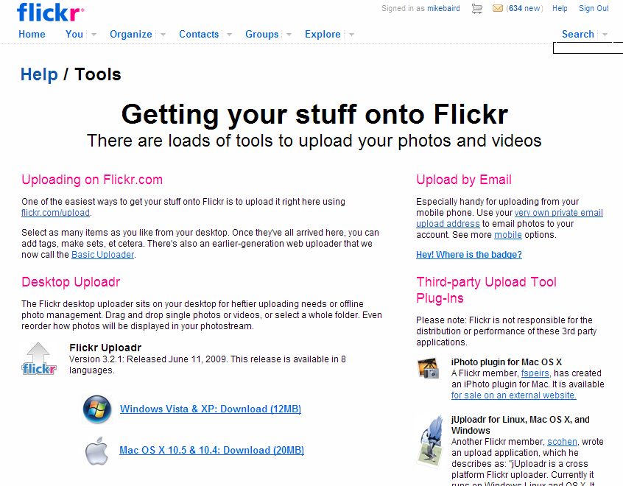
Desktop Uploader, Email, Plugins

Slide 49
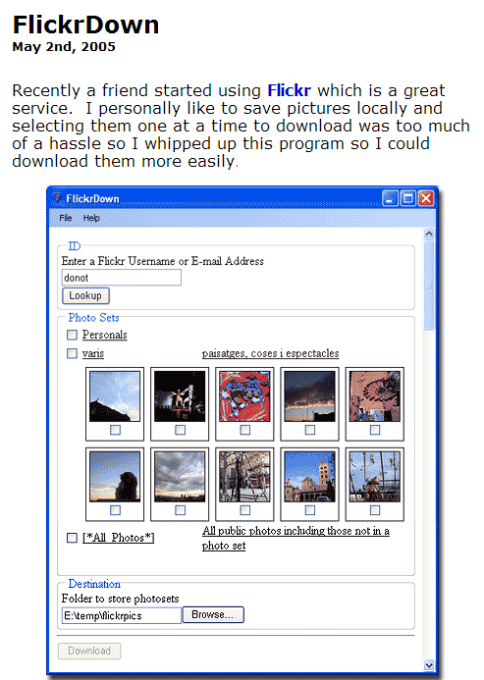
Download Photos in mass
FlickrDown by
Greggman greggman.com greggman.com/pages/flickrdown.htm

Slide 50
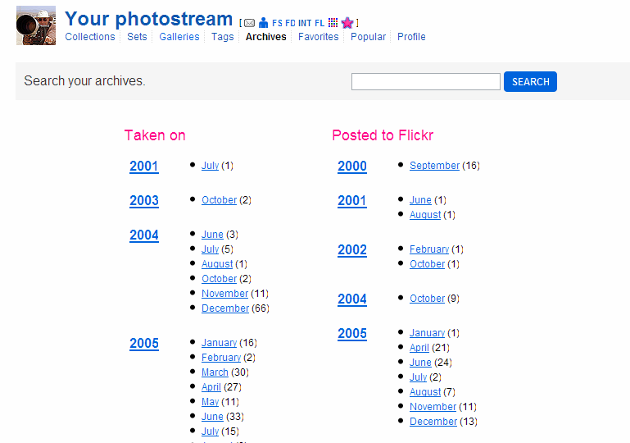
Complete Archives

Slide 51
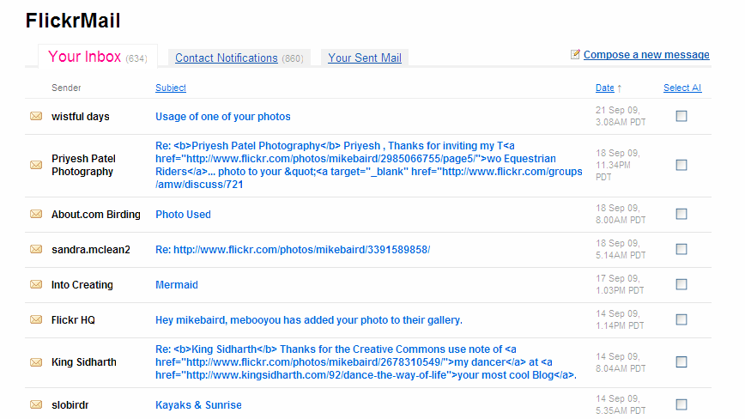
FlickrMail

Slide 52
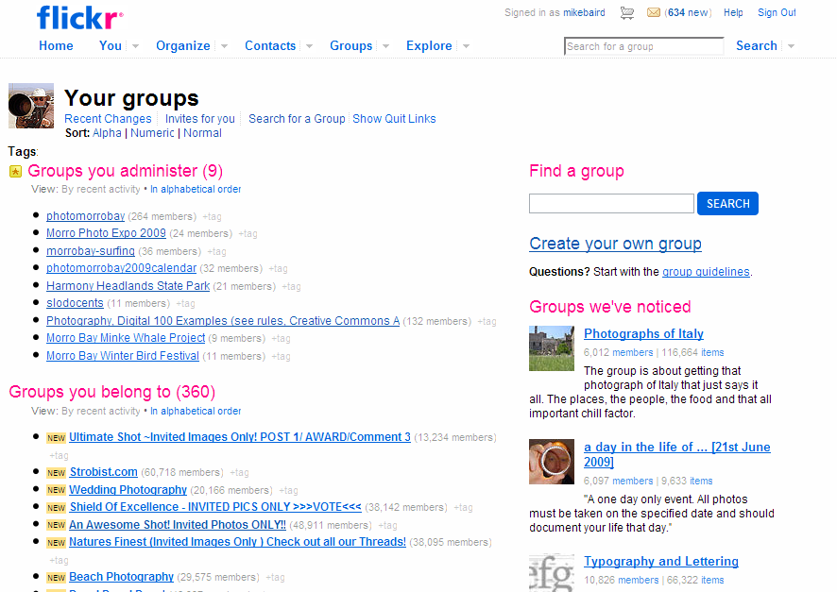
Groups and Pools

Slide 53
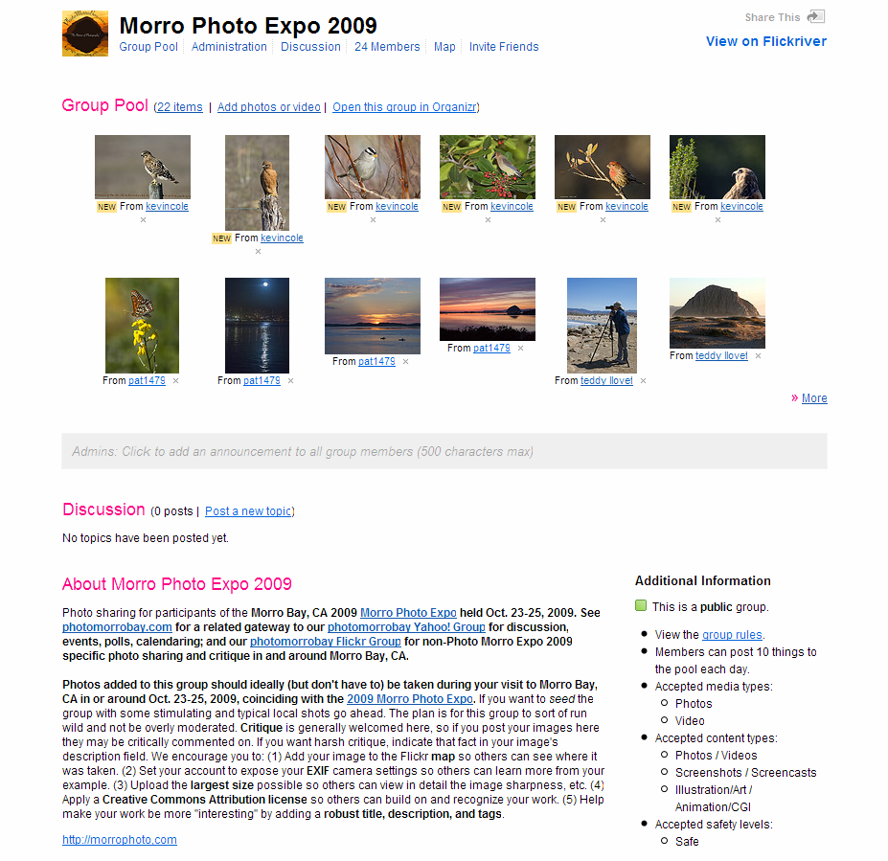
Group for Morro Photo Expo 2009
http://www.flickr.com/groups/morrophotoexpo2009/

Slide 54
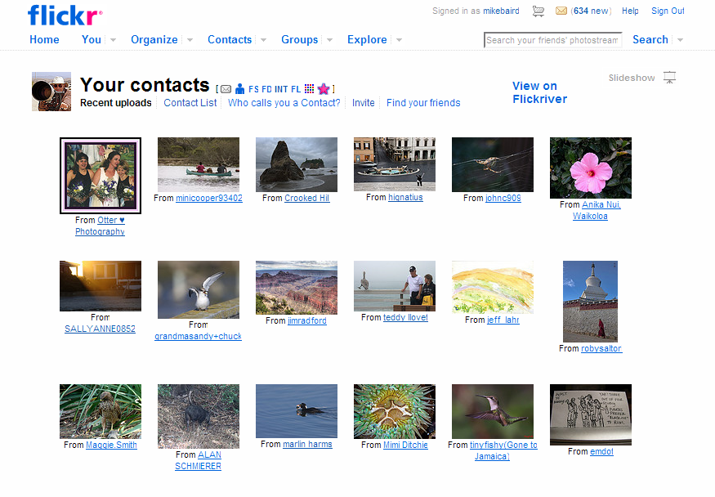
Your Contacts – Recent uploads

Slide 55
Firefox Extensions for Flickr
http://www.flickr.com/people/mikebaird/ says...
How to vastly improve your Flickr browsing experience (reduce number of clicks by 10X) using Firefox (the only browser I use), Firefox Add-ons, and Greasemonkey Scripts. Download and install the Firefox Browser (which is much better than Internet Explorer) from www.mozilla.com/en-US/firefox/?from=getfirefox . Add the Greasemonkey Firefox Add-on addons.mozilla.org/en-US/firefox/addon/748 . (Add-ons extend Firefox, letting you personalize your browsing experience.) Go to userscripts.org/ - search there for "Flickr" or say "Flickr Exif" - sort by number of "installs" and you will find the most popular and useful scripts. Here are some I like to use currently... these are managed in Firefox under Tools > Greasemonkey > Manage User Scripts. Experiment with what works for you. New and updated scripts are constantly being added. This list is current as of May 2008. Better Flickr 0.3, Flickr Groups Organiser, Flickr Exif Info, Flickr Exif Decorator, Flickr image unblocker, Flickr Buddy Icon Reply, Flickr - Multi Group Sender, Flickr Rich Edit, Flickr Auto Page, Flickr Group Page Enhancer, Flickr Refer Comment, FlickrPM, Flickr Photostream Graphr, Flickr Contacts Organiser, Flickr MultiMailer. FlickrDown (untested?) (download Groups...) Flickr Original (untested?) (download original from thumbnail) Saleen Flickr Downloader (rec'd by Kevin Cole) Steeev's Flickr Projects contain the most valuable and comprehensive scripts of all - no contest! Also make sure you have Exif Viewer by Alan Raskin

Slide 56
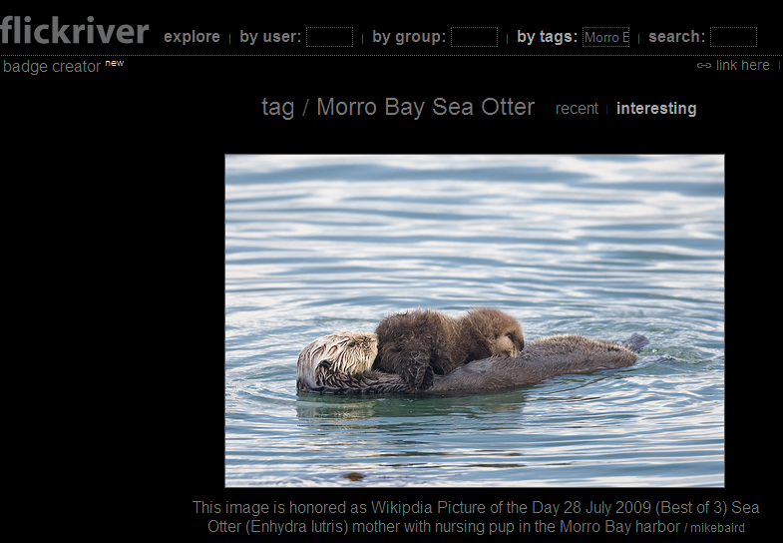
Discover Paradigm: Search vs. browse
Application Program Interfaces (APIs) allow discovery of your images. e.g., Flickriver (view by recent, interesting...). Example “Morro Bay Sea Otter”

Slide 57
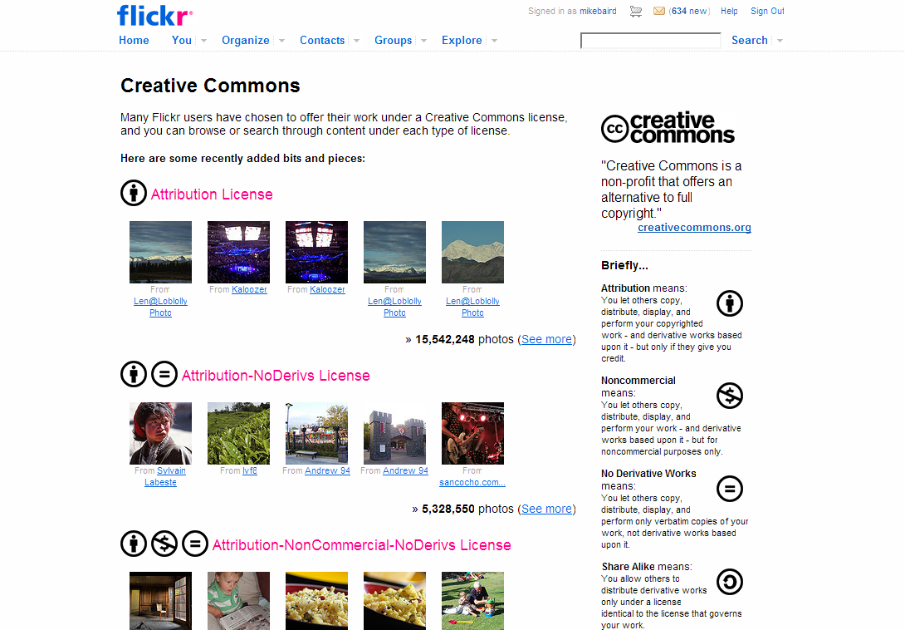
Creative Commons

Slide 58
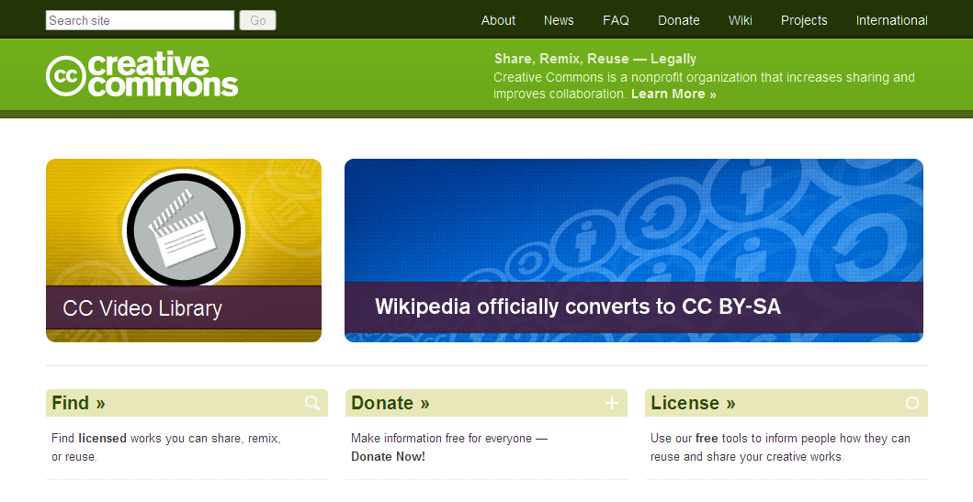
Creativecommons.org

Slide 59
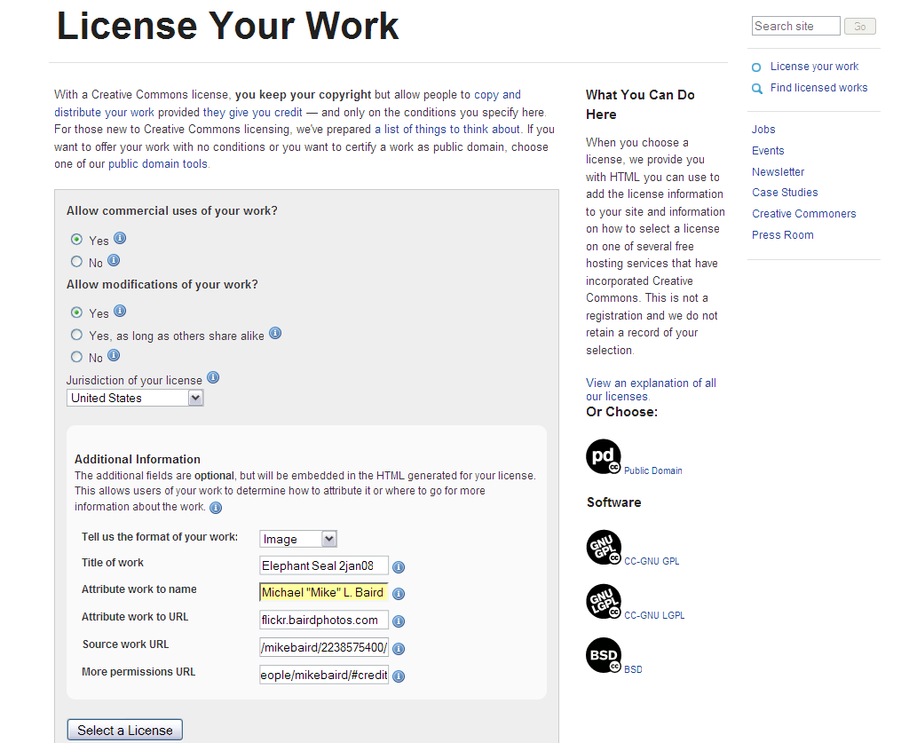
Creative Commons License Generation

Slide 60
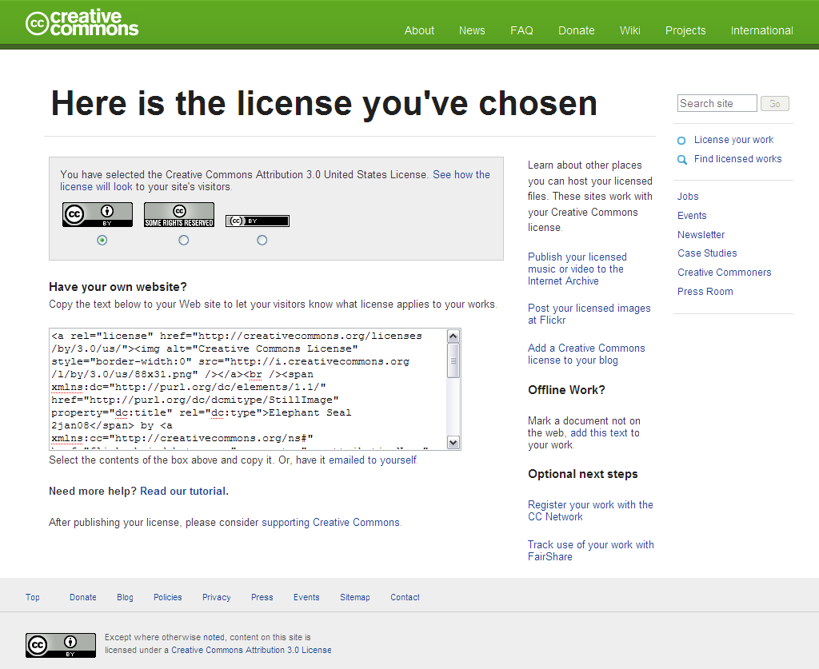
License

Slide 61
Wikimedia Commons
commons.wikimedia.org
1000’s of Wikipedians scour Flickr for images to be added to a 5 million archive
Check out your images that made Wikimedia Commons - if you use Flickr and use the Creative Commons Attribution license (highly encouraged), your images are very likely making their way (through the efforts of many Wikipedians worldwide) into a perpetual existence - your only significant legacy perhaps.
Wikimedia Commons is a media file repository making available public domain and freely-licensed educational media content (images, sound and video clips) to everyone, in their own language. It acts as a common repository for the various projects of the Wikimedia Foundation, but you do not need to belong to one of those projects to use media hosted here. The repository is created and maintained not by paid-for artists but by volunteers.

Slide 62
Wikimedia Commons Group http://www.flickr.com/groups/wikimedia_commons/pool/

Slide 63
Wikimedia Commons

Slide 64
Photomorrobay.com Gateway
Photomorrobay Yahoo! Group (discussion)
Photomorrobay Flickr Group/Pool (sharing)

Slide 65
Photomorrobay Yahoo! Group
http://tech.groups.yahoo.com/group/photomorrobay/

Slide 66
Use iStockPhoto to sell images
istockphoto.com

Slide 67
Use iStockPhoto to sell images

Slide 68
Facebook Integration

Slide 69
Thanks for listening! Michael “Mike” L. Baird bairdphotos.com flickr.bairdphotos.com flickr.com/people/mikebaird photomorrobay.com mike [at} mikebaird d o t com (first-time email: please add “must read” to subject line)

